Slide 1
BIA 650 – Process Optimization and Analytics
5. Network Models
Transportation Problem
Network Formulation
Assignment Models
General Logistics Models
Flows through time
Notes:
This course is about designing organizations and processes.
Processes are the means through which work gets done. (Good people can’t overcome poor processes (Peter Keen)
Often the design approach will involve the use of IT. But people are just as important. We will try to take a balanced view.
How do we know if an organization is more efficient? More effective?
(Both efficiency & effectiveness are important, but many “efficient” organizations are now out of business.
In this lecture, we concentrate on how we can measure the efficiency (productivity) of organizations and processes. Unless we can measure improvement, we can not tell if our design intervention has been useful.
Three approaches to answering this question:
Economist’s - Data Envelopment Analysis
Accountant’s - Activity-based Costing (ABC)
Financial - ROI and Economic Value added (EVA)

Slide 2
Transportation Problem
m Factories, i,
with production capacity Si
n Warehouses, j,
with demand Dj
Xij = amount shipped on route i to j
Cij = cost per unit to ship on route i to j
Min ∑∑ Cij.Xij
i j
Subject to:
∑ Xij > Dj, j = 1,2, …, n
i
∑ Xij < Si, i = 1,2, …, m
j
Xij > 0, i = 1,2, …, m; j = 1,2, …, n
Notes:
∑Si > ∑Dj
i j
The constraints can be expressed as equalities.
It can be shown that if Si and Dj are integer then Xij will be integer (no fractional solutions.)

Slide 3
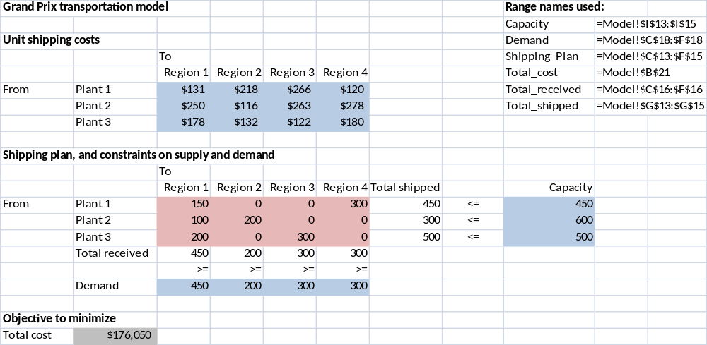
Transportation Model (W&A Ex. 5.1)
Note: Capacity (supply) exceeds demand

Slide 4
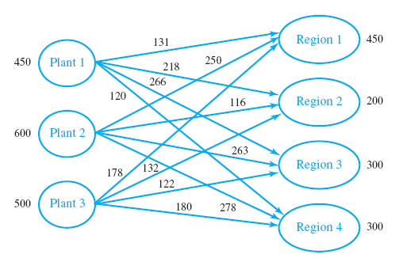
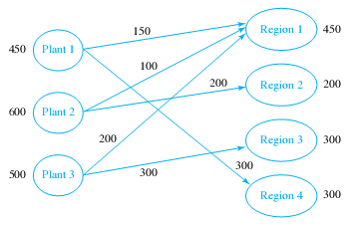
Transportation Problem
Problem –
Costs on Arcs
Solution –
Shipments on
Arcs

Slide 5
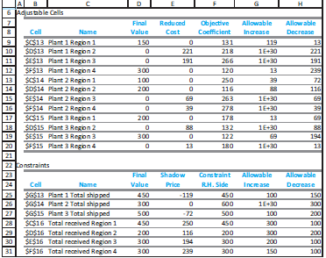
Grand Prix: Sensitivity Analysis

Slide 6
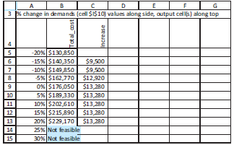
Sensitivity to Demand
Using Solver Table:
If Demand exceeds Capacity, add a “dummy” factory so that total capacity equals total demand. Set the shipment costs from the dummy to all demand points equal to zero.

Slide 7
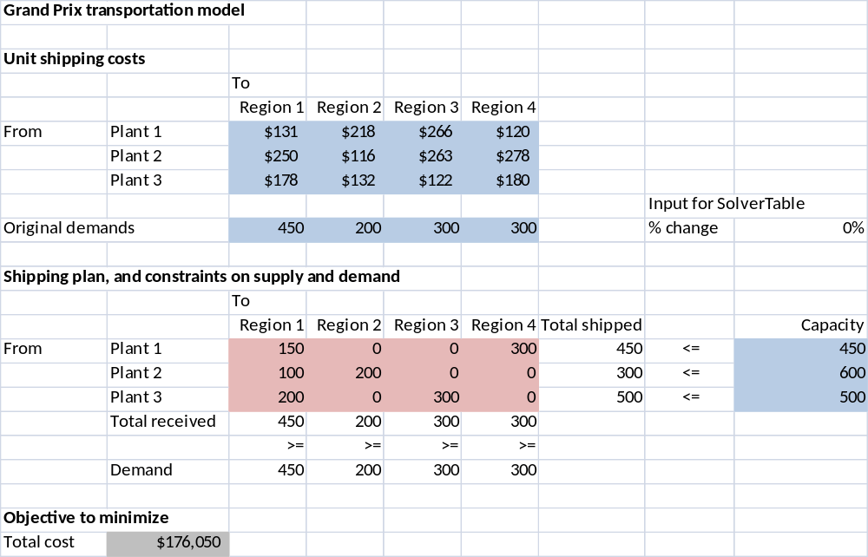
Grand Prix Solver Table
How do costs vary with changes in demand?
Add special input variable for Solver Table
Cell $I$10)
Modify Demands so that they vary with % change
=C10*(1+$I$10)

Slide 8
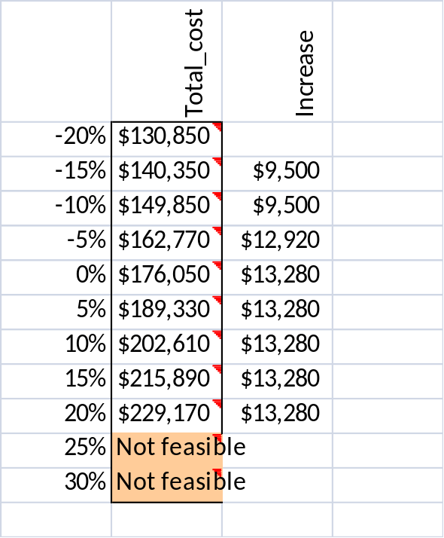
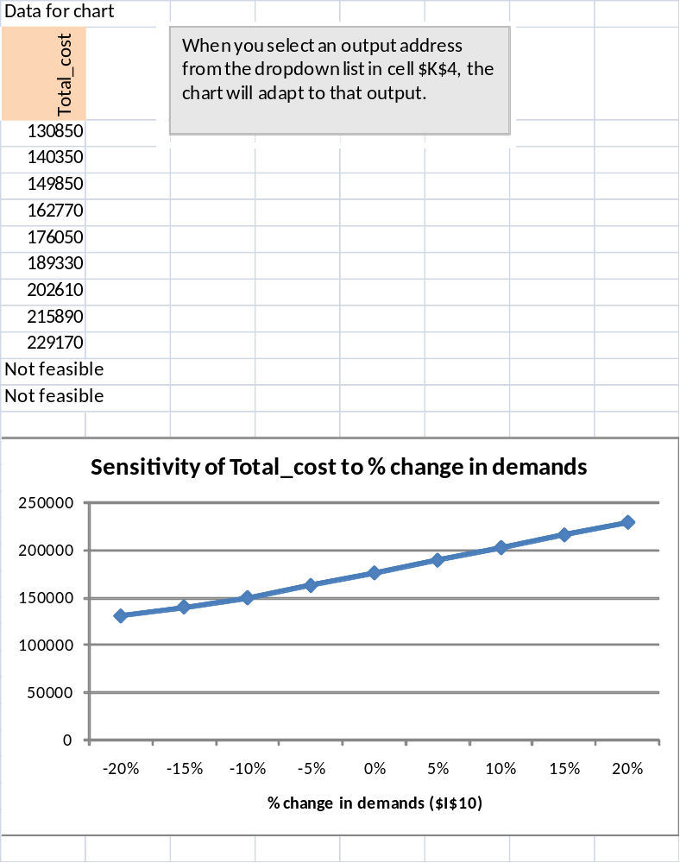
Solver Table Output
If Demand exceeds Capacity, add a “dummy” factory so that total capacity equals total demand. Set the shipment costs from the dummy to all demand points equal to zero.

Slide 9
Ex 5.2 Grand Prix – with production Costs and Taxes
Input data
Unit shipping costs (shipping only)
 |  | To |  |  |  |  | Plant data
 |  | Region 1 | Region 2 | Region 3 | Region 4 |  | Unit cost | Tax rate
From | Plant 1 | $131 | $218 | $266 | $120 |  | $14,350 | 30%
 | Plant 2 | $250 | $116 | $263 | $278 |  | $16,270 | 35%
 | Plant 3 | $178 | $132 | $122 | $180 |  | $16,940 | 22%
Unit selling prices at regions |  | $19,290 | $20,520 | $17,570 | $18,320
Shipping plan, and constraints on supply and demand
 |  | To
 |  | Region 1 | Region 2 | Region 3 | Region 4 | Total shipped |  | Capacity
From | Plant 1 | 450 | 0 | 0 | 0 | 450 | <= | 450
 | Plant 2 | 0 | 0 | 300 | 300 | 600 | <= | 600
 | Plant 3 | 0 | 500 | 0 | 0 | 500 | <= | 500
 | Total received | 450 | 500 | 300 | 300
 |  | >= | >= | >= | >=
 | Demand | 450 | 200 | 300 | 300
Monetary outputs
After-tax profit per unit produced in given plant and sold in given region
 |  | Region 1 | Region 2 | Region 3 | Region 4
 | Plant 1 | $3,366.30 | $4,166.40 | $2,067.80 | $2,695.00
 | Plant 2 | $1,800.50 | $2,687.10 | $674.05 | $1,151.80
 | Plant 3 | $1,694.16 | $2,689.44 | $396.24 | $936.00
Objective to maximize
After-tax profit | $3,407,310
=(Selling price-Production cost-Shipping cost) * Tax rate
=(C$11-$H7-C7)*(1-$I7)
=SUMPRODUCT(C29:F31,Shipping_plan)

Slide 10
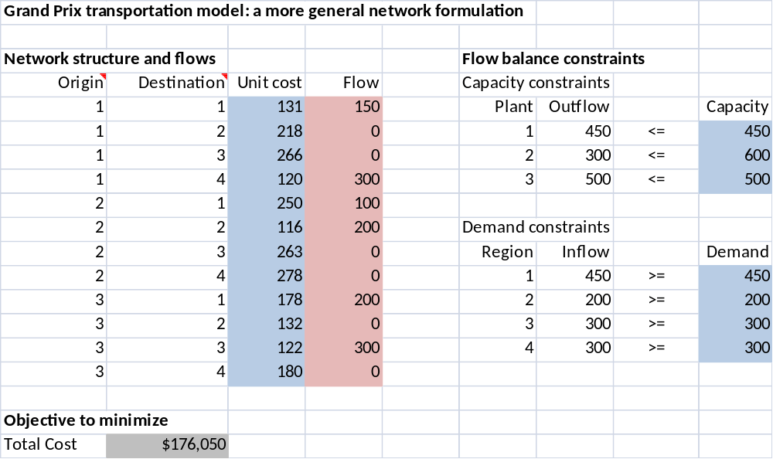
Network Flow Representation of the Transportation Problem
W&A Example 5.2
=Sumif(Origin,F6,Flow)
=Sumif(Destination,F12,Flow)

Slide 11
Assignment Models
Assignment models are used to assign, on a one-to-one basis, the members of one set to members of another set in a least-cost (or least-time) manner.
The prototype assignment model is the assignment of machines to jobs.
  For example, suppose there are four jobs and five machines. Every pairing of a machine and a job has a given job completion time. The problem is to assign the machines to the jobs so that the total time to complete all jobs is minimized.

Slide 12
Assignment Models (ctd.)
  Comparing to the transportation problem, think of the machines as the suppliers, the jobs as the customers, and the job completion times as the unit shipping costs.
  The capacity of any machine represents the most jobs it can handle.
  The “demand” of any job is the number of times it must be done, usually 1.
  There is an arc from every machine to every job it can handle, and the allowable flows on these arcs are all 0 or 1 –
  a particular machine is either paired with a particular job (a flow of 1) or it isn’t (a flow of 0).
  Therefore, this assignment problem can be modeled exactly like the transportation problem.

Slide 13
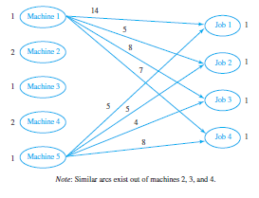
Assignment models (ctd)
Times job must be executed
Machine Capacity
Time to execute job

Slide 14
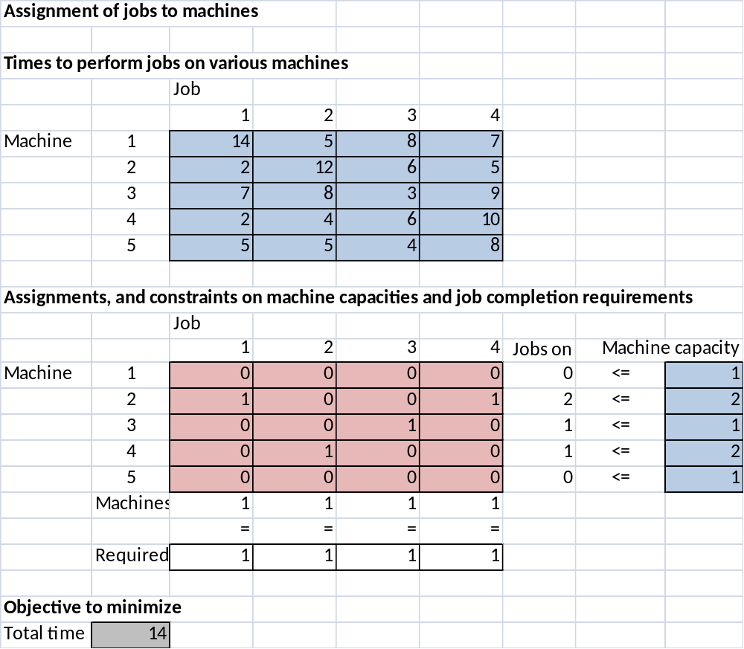
Assignment Problem (ctd.)

Slide 15
Assignment models (ctd.)
The optimal solution above indicates, by the 1s and 0s in the changing cells, which machines are assigned to which jobs.
Specifically, machine 2 is assigned to jobs 1 and 4, machine 3 is assigned to job 3, machine 4 is assigned to jobs 1 and 2, and machines 1 and 5 are not assigned to any jobs. With this optimal assignment, it takes 14 time units to complete all jobs.
.

Slide 16
General Logistics Models
The objective of many real-world network models is to ship goods from one set of locations to another set of locations at minimum cost, subject to various constraints. There are many variations of these models.
The general logistics problem is similar to the transportation problem except for two possible differences.
  Arc capacities are often imposed on some or all of the arcs. These become simple upper bound constraints in the model.
  Inflows and outflows can be associated with any node. Nodes are generally categorized as origins, destinations, and transshipment points.

Slide 17
Logistics - Some Definitions
An origin is a location that starts with a certain supply (or possibly a capacity for supplying). A destination is the opposite; it requires a certain amount to end up there. A transshipment point is a location where goods simply pass through.
Net inflow and net outflow.
  The net inflow for any node is defined as total inflow minus total outflow for that node.
  The net outflow is the negative of this, total outflow minus total inflow.

Slide 18
Other logistics models (ctd.)
Using the above convention, an origin is a node with positive net outflow, a destination is a node with positive net inflow, and a transshipment point is a node with net outflow (and net inflow) equal to 0.
It is important to realize that inflows are sometimes allowed to origins, but their net outflows must be positive.
Similarly, outflows from destinations are sometimes allowed, but their net inflows must be positive.

Slide 19
Other logistics models (ctd.)
Two constraint types:
  arc capacity constraints (simple upper bounds on the arc flows._
  flow balance constraints, one for each node.
    For an origin, this constraint is typically of the form Net Outflow = Original Supply or possibly Net Outflow < Capacity.
    For a destination, it is typically of the form Net Inflow > Demand or possibly Net Inflow = Demand.
    For a transshipment point, it is of the form Net Inflow = 0 (which is equivalent to Net Outflow = 0).

Slide 20
Example 5.4: Redbrand
The RedBrand Company produces tomato products at three plants.
These products can be shipped directly to their two customers or they can first be shipped to the company’s two warehouses and then to the customers.
The problem is to find the least cost way to ship the tomatoes possibly using the warehouses.

Slide 21
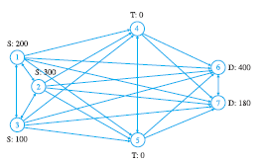
Example 5.4 - Redbrand
S = Supply Point
T = Transshipment Point
D = Demand Point
Arcs can be bi-directional (e.g., between 6 & 7)

Slide 22
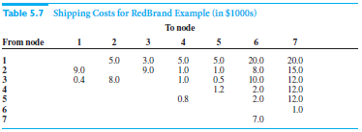
Example 5.4 – Redbrand ctd.
Assume at most 200 tons of product can be shipped between nodes.

Slide 23
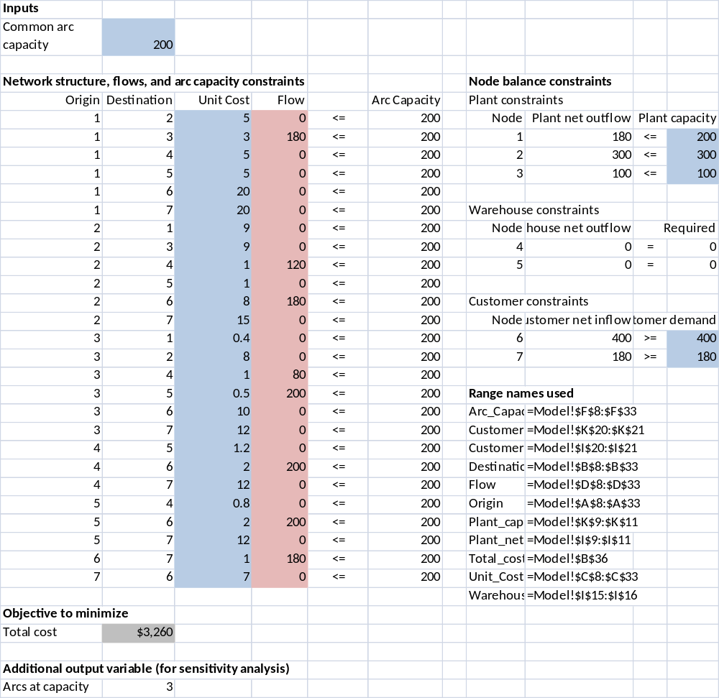
Example 5.4 - Redbrand
'=SUMIF(Origin,H9,Flow)-SUMIF(Destination,H9,Flow)

Slide 24
Example 5.6 Background
VanBuren would like to devise a strategy for purchasing machines over the next 5 years.
As a matter of policy, the company never sells a machine that is less than 1 year old, and it never keeps a machine that is more than 3 years old.
Also the machine in use at the beginning of the current quarter is brand new.
Objective: To find the optimal replacement strategy by modeling the problem as an equivalent shortest path problem.

Slide 25

Example 5.6 continued:
In general, a company would gather historical data on maintenance costs and salvage values for similar machines and fit appropriate curves to the data.
The variables and constraints are shown here.

Slide 26
Example 5.6 continued
The network is constructed as follows.
  There is a node for each quarter, including the current quarter and the quarter exactly five years (20 quarters) from now. (Remember that VanBuren uses a five-year planning horizon.)
  These nodes are labeled 1 through 21, where node 1 is the current quarter, node 2 is the next quarter, and so on.
  There is an arc from each node to each later node that is at least 4 quarters ahead but no more than 12 quarters ahead.
  Several of these arcs are shown on the next slide.

Slide 27
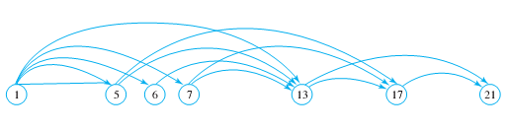
Example 5.6 continued
An entire strategy for the 5-year period is a string of arcs.
  For example, if the shortest path is 1-9-17-21, then VanBuren keeps the first machine for 8 quarters, trades it in for a second machine at the beginning of quarter 9, keeps the second machine for 8 quarters, trades it in for a third machine at the beginning of quarter 17, keeps the third machine for 4 quarters, and finally trades it in for a fourth machine at the beginning of quarter 21.

Slide 28
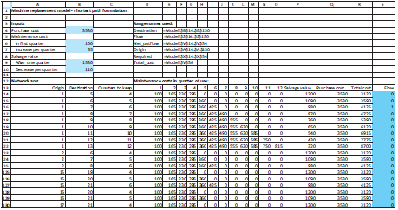
Example 5.6 continued
=IF(D$13>$C14,0,$B$6+$B$7*(D$13-1))

Slide 29
Example 5.6 continued
The model can be completed with the following steps.
  Inputs. Enter the inputs for the purchase cost, maintenance costs, and salvage values in the blue ranges.
  Arcs. In the bottom section, columns A and B indicate the arcs in the network. Enter these “origins” and “destinations” manually. Make sure that the difference between them is at least 4 and no greater than 12. Also, make sure that the origin is at least 1 and the destination is no more than 21.

Slide 30
Example 5.6 continued:
Developing the model
  Quarters to keep. Calculate the differences between the values in columns B and A in column C. These differences indicate how many quarters the machine is kept for each arc.
  Maintenance costs. Calculate the quarterly maintenance costs in columns D through O. Fortunately, you can calculate all of these maintenance costs at once by entering the formula
  =IF(D$13>$C14,0,$B$6+$B$7*(D$13-1)) in cell D14 and copying it to the range D14:O130. The IF Function ensures that no maintenance costs for this machine are incurred unless the machine is still in use.

Slide 31
Example 5.6 continued:
Developing the model
  Salvage values. In a similar way, calculate the salvage values in column P by entering the formula =$B$9-$B$10*(C14-1) in cell P14 and copying down column P.
  Purchase cost. The purchase cost of a new machine never changes, so put an absolute link to cell B4 in cell Q14, and copy it down column Q.
  Total arc costs. Calculate the total costs on the arcs as total maintenance cost minus salvage value plus purchase cost. To do this, enter the formula =SUM(D14:O14)-P14+Q14 in cell R14, and copy it down column R.
  Flows. Enter any flows on the arcs in column S.

Slide 32
Example 5.6 continued:
Using Solver
From this point, the model is developed exactly as in the shortest path model of Example 5.5, with node 1 as the “origin” node and node 21 as the “destination” node.
We create the flow balance constraints, calculate the total network cost, and use Solver exactly as before, so we won’t repeat the details here.

Slide 33
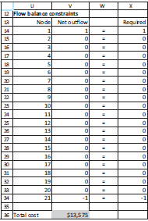
Example 5.6 continued:
Solution
The constraints and objective for machine replacement model are shown here
We find the shortest path, we follow the 1s in the Flow range to identify the optimal equipment replacement policy.
The total cost of this strategy is $13,575.

Slide 34
Example 5.6 continued:
Solution
Solver finds the minimum-cost replacement strategy. Try your own strategy, just to make sure you understand how the network works.
For example, see if you can enter the appropriate flows for the strategy that replaces the machine in quarters 6, 11, 17, and 21.
Your flows should automatically satisfy the flow balance constraints, and your total cost should be $14,425.
Of course, this is a suboptimal solution; its cost is higher than the minimum cost found with Solver.

